Slide 1
Data Types, Operators and Expressions
Java Programming
AAPP004-4-2
Copyright 2016 Asia Pacific Institute of Information Technology

Slide 2
Topic & Structure of the lesson
Overview of
  Identifiers
  Data types
  Operators
  Expressions
Slide <number> of 35

Slide 3
Learning Outcomes
At the end of this topic, you should be able to:
Define and differentiate the various data types in Java
Use operators in Java programs and subsequently write expressions that make up a Java program
Slide <number> of 35

Slide 4
Key Terms you must be able to use
If you have mastered this topic, you should be able to use the following terms correctly in your assignments and exams:
identifiers
primitive data types
derived data types
operators
expressions
Slide <number> of 35

Slide 5
Identifiers/Variables
Variables
int temperature; // The Fahrenheit temperature
Think of variable like a container for a value :
32
temperature
temperature = 32; // temperature contains the value 32
The above is an assignment statement and “=“ is the assignment operator.
Slide <number> of 35

Slide 6
Identifiers/Variables
To declare > 1 variable :
int fahrTemp, centTemp;
int is the type name
Legal variable name must consists of a letter (upper- or lowercase) followed by any number (including zero) of letters & digits.
Illegal variable names : 4.7 !%--
Legal variable names :
temperature TEMP23 T $temp_1 T$$1
Slide <number> of 35

Slide 7
Identifiers/Variables
int Temp;
temp=3;
cause Java to give the error
Undefined variable; temp
To declare a constant value :
final double PI = 3.14159;
Slide <number> of 35

Slide 8
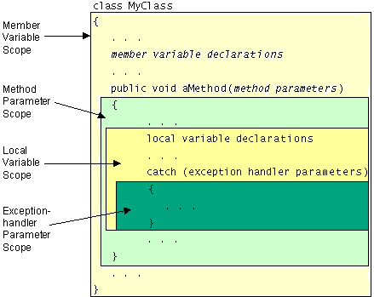
Scope of Variables
A variable's scope is the block of code within which the variable is accessible and determines when the variable is created and destroyed. The location of the variable declaration within your program establishes its scope and places it into one of these 4 categories:
    Member variable
    Local variable
    Method parameter
    Exception-handler
    parameter
Slide <number> of 35

Slide 9
Keywords
Keywords ~ words that may seems to be legal variable names but they are not because they are reserved by the language for special uses.
List of Keywords in Java :
abstract
catch
do
finally
if
interface
outer
return
this
var
boolean char
double
float
implements
long
package
short
throw
void
break
class
else
for
import
native
private
static
throws
volatile
byte
const
extends
future
inner
new
protected
sure
transient
while
case
continue
false
generic
instanceof
null
public
switch
true
cast
default
final
goto
int
operator
rest
synchronized
try
Slide <number> of 35

Slide 10
Data types
All variables must have a data type and must be initialized.
Eg. int count=3;
or
int count;
count=3;
Slide <number> of 35

Slide 11
Data types
Java language is rich in its data types.
The variety of data types available allow the
programmer to select the type appropriate to
the needs of the application.
Two major categories of data type :
    Primitive (Built in types)
    Reference / Object (Derived Types)
Slide <number> of 35

Slide 12
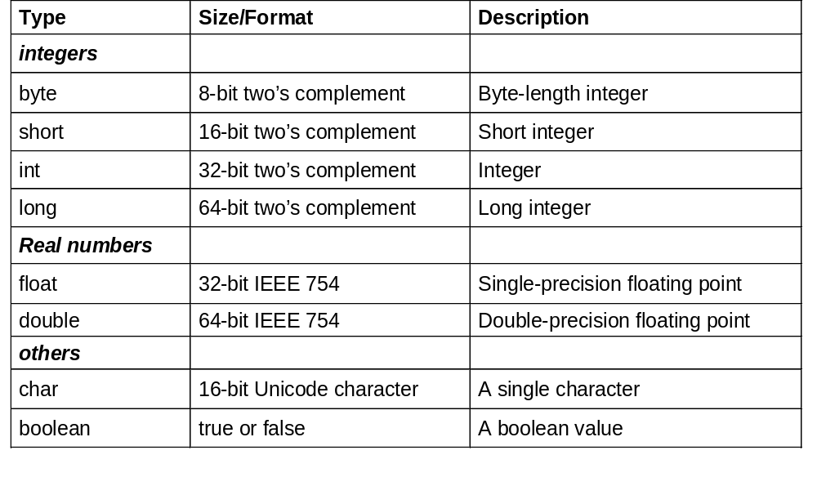
Data types – primitive data types
Slide <number> of 35

Slide 13
Data types – primitive data types
Examples of double values in Java :
3.14159 7.12 9.0 0.5e001 -16.3e+002
The e is called the e-notation in Java;
e separates the number from the exponent.
2.829281 x 10^{8 <=>} 2.829281e8
2. 13898121 x 10^{-15 <=>} 2. 13898121e-15
Slide <number> of 35

Slide 14
Data types – reference data types
Reference types :
  Arrays
  Classes
  The value of a reference type variable, is a reference to the actual value or set of values represented by the variable.
Slide <number> of 35

Slide 15
Data types – reference data types
  Example – class references
  Classes are the templates for creating objects.
  class A
  {
  variables
  constructors
  methods
  }
  A a = new A( ) a is a reference to an object of class A
Slide <number> of 35

Slide 16
Data types – reference data types
  Example – Array references
  int myArray [ ] = new int [4];
Slide <number> of 35

Slide 17
Operators in Java
What is an operator?
An operator takes one or more arguments (operands) and produces a new value
An operator in Java can be
  Unary: operates on a single operand
  Binary: operates on 2 operands
  Ternary: operates on 3 operands
A Java operator can be further classified in accordance with the scheme as shown in the slide that follows
Slide <number> of 35

Slide 18
Operators in Java
Java supports a rich set of operators which can be
classified into six categories:
1. Arithmetic operators
2. Relational operators
3. Logical operators
Increment/Decrement operators
Assignment operators
Slide <number> of 35

Slide 19
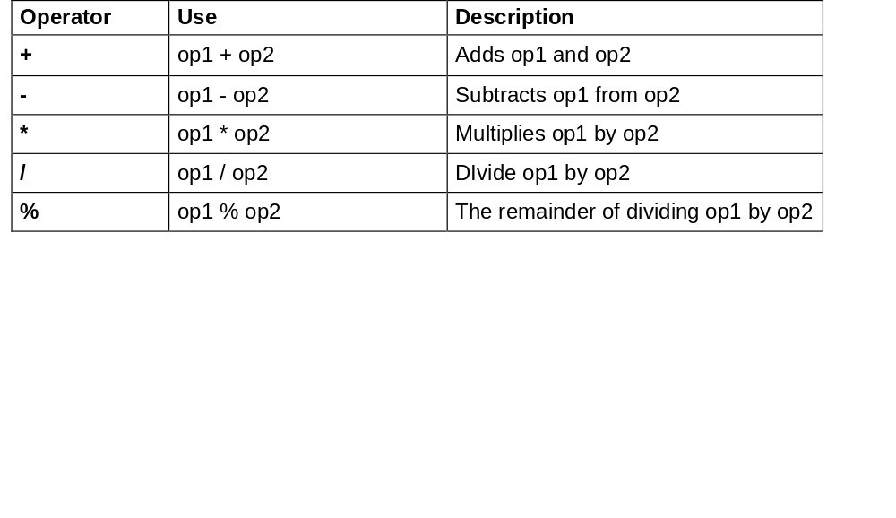
Operators in Java
Arithmetic Operators
  Java language supports the arithmetic operators as listed below for all integer and real numbers :
Slide <number> of 35

Slide 20
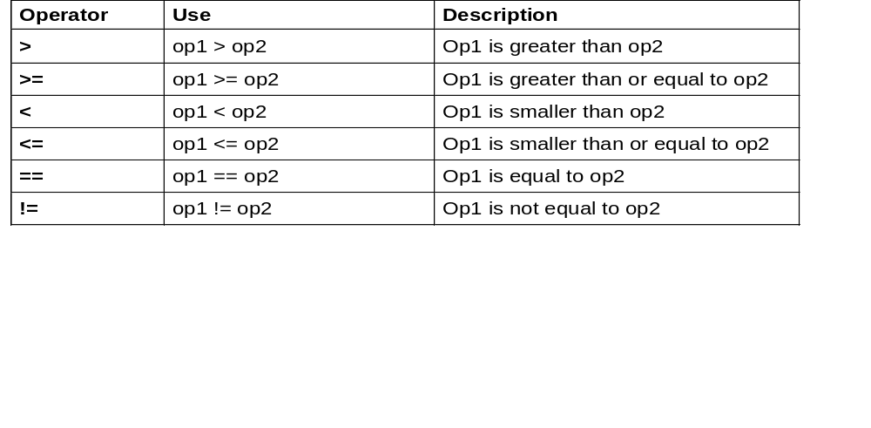
Operators in Java
Relational
  A relational operator compares 2 values and determines the relationship between them.
Slide <number> of 35

Slide 21
Operators in Java
Logical Operators
  Relational operators are often used with logical operators to construct more complex decision-making expressions.
Operator
Use
Description
&&
op1 && op2
op1 and op2 are both true,
conditionally
evaluates op2
||
op1 || op2
Either op1 and op2 are true,
conditionally
evaluates op2
!
! op
op is false
&
op1 & op2
op1 and op2 are both true,
always
evaluates op2
|
op1 | op2
Either op1 and op2 are true,
always
evaluates op2
Shorthand for and
if-else statement
?:
expression ? op1 : op2
The ?: operator evaluates expression
and returns op1 if it’s true and op2 if
it’s false
Slide <number> of 35

Slide 22
Operators in Java
Bitwise Operators
  Bitwise operators can be
  1. Logical
  2. Shift
Slide <number> of 35

Slide 23
Operators in Java
Bitwise Operators
Logical operators
  & bitwise AND
  | bitwise OR
  ^ bitwise (XOR)
  ~ bitwise complement
Slide <number> of 35

Slide 24
Operators in Java
Bitwise Operators
Shift operators
  >> shift right with sign extension
  >>> shift right with zero fill
  << shift left with zero fll
  General form
  Value << num
  Value >> num
  Value >>> num
Slide <number> of 35

Slide 25
Operators in Java
Bitwise Operators
Shift operators
  Examples
  16 >> 2
  returns 4
  2. -16 >> 2
  returns -4
  3. 100 >>> 2
  returns 25
Slide <number> of 35

Slide 26
Operators in Java
Increment/decrement Operators
++ increase value by 1
- decrease value by 1
Eg.
i++ OR ++i
k- - OR - -k
Slide <number> of 35

Slide 27
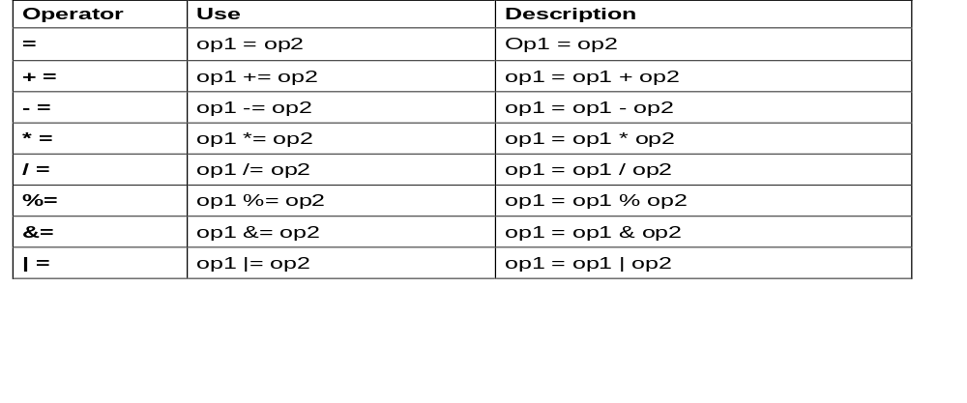
Operators in Java
Assignment Operators
Assignment operators are used to assign one value to another. Listed below are the basic assignment operators (=) as well as the shortcut assignment operators.
Slide <number> of 35

Slide 28
Expressions
Definition : An expression is a series of variables,
operators and method calls (constructed according to
the syntax of the language) that evaluates to a single
value.
Expression perform the work of a Java program.
Expressions are used to :
    compute (eg. totalPrice = productCost + shippingCost)
    assign values to variables (eg. count = 10)
    to help control the execution flow of a program
    (eg while (count <10) count++;)
Slide <number> of 35

Slide 29
Expressions
Basically, there are 2 types of expressions :
Expression with operators
eg.
      temperature = 98;
      total = (count + 10)* 25 / 4;
      count++;
Slide <number> of 35

Slide 30
Expressions
Method call expression
      eg. keyboard.nextInt(),
      Integer.parseInt()
      A method(function) call evaluates to the return value of the method.
      The return data type of a method expression call is the same as the data type of the return value of that method.
Slide <number> of 35

Slide 31
Follow Up Assignment
Write an expression that returns the solution for the general form of the quadratic equation as shown below
ax² + bx + c = 0
Slide <number> of 35

Slide 32
Quick Review Question
We are going to work together to write some more Java programs that we can test in the lab.
1. Write a Java program to display the lines:
This is the first line.
This is the second line.
2. Write a Java program to
Assign the value 45.35 to the float variable price, 10 to the integer variable units and calculate and display the total value of price * units
Slide <number> of 35

Slide 33
Topic & Structure of the lesson
Overview of
  Identifiers
  Data types
  Operators
  Expressions
Slide <number> of 35

Slide 34
Question and Answer Session
Q & A
Slide <number> of 35

Slide 35
Next Session
Conditional constructs
  If… else construct
  Nested if…else constructs
  Switch…. Case
Break and continue statements
Slide <number> of 35

